Slide 1
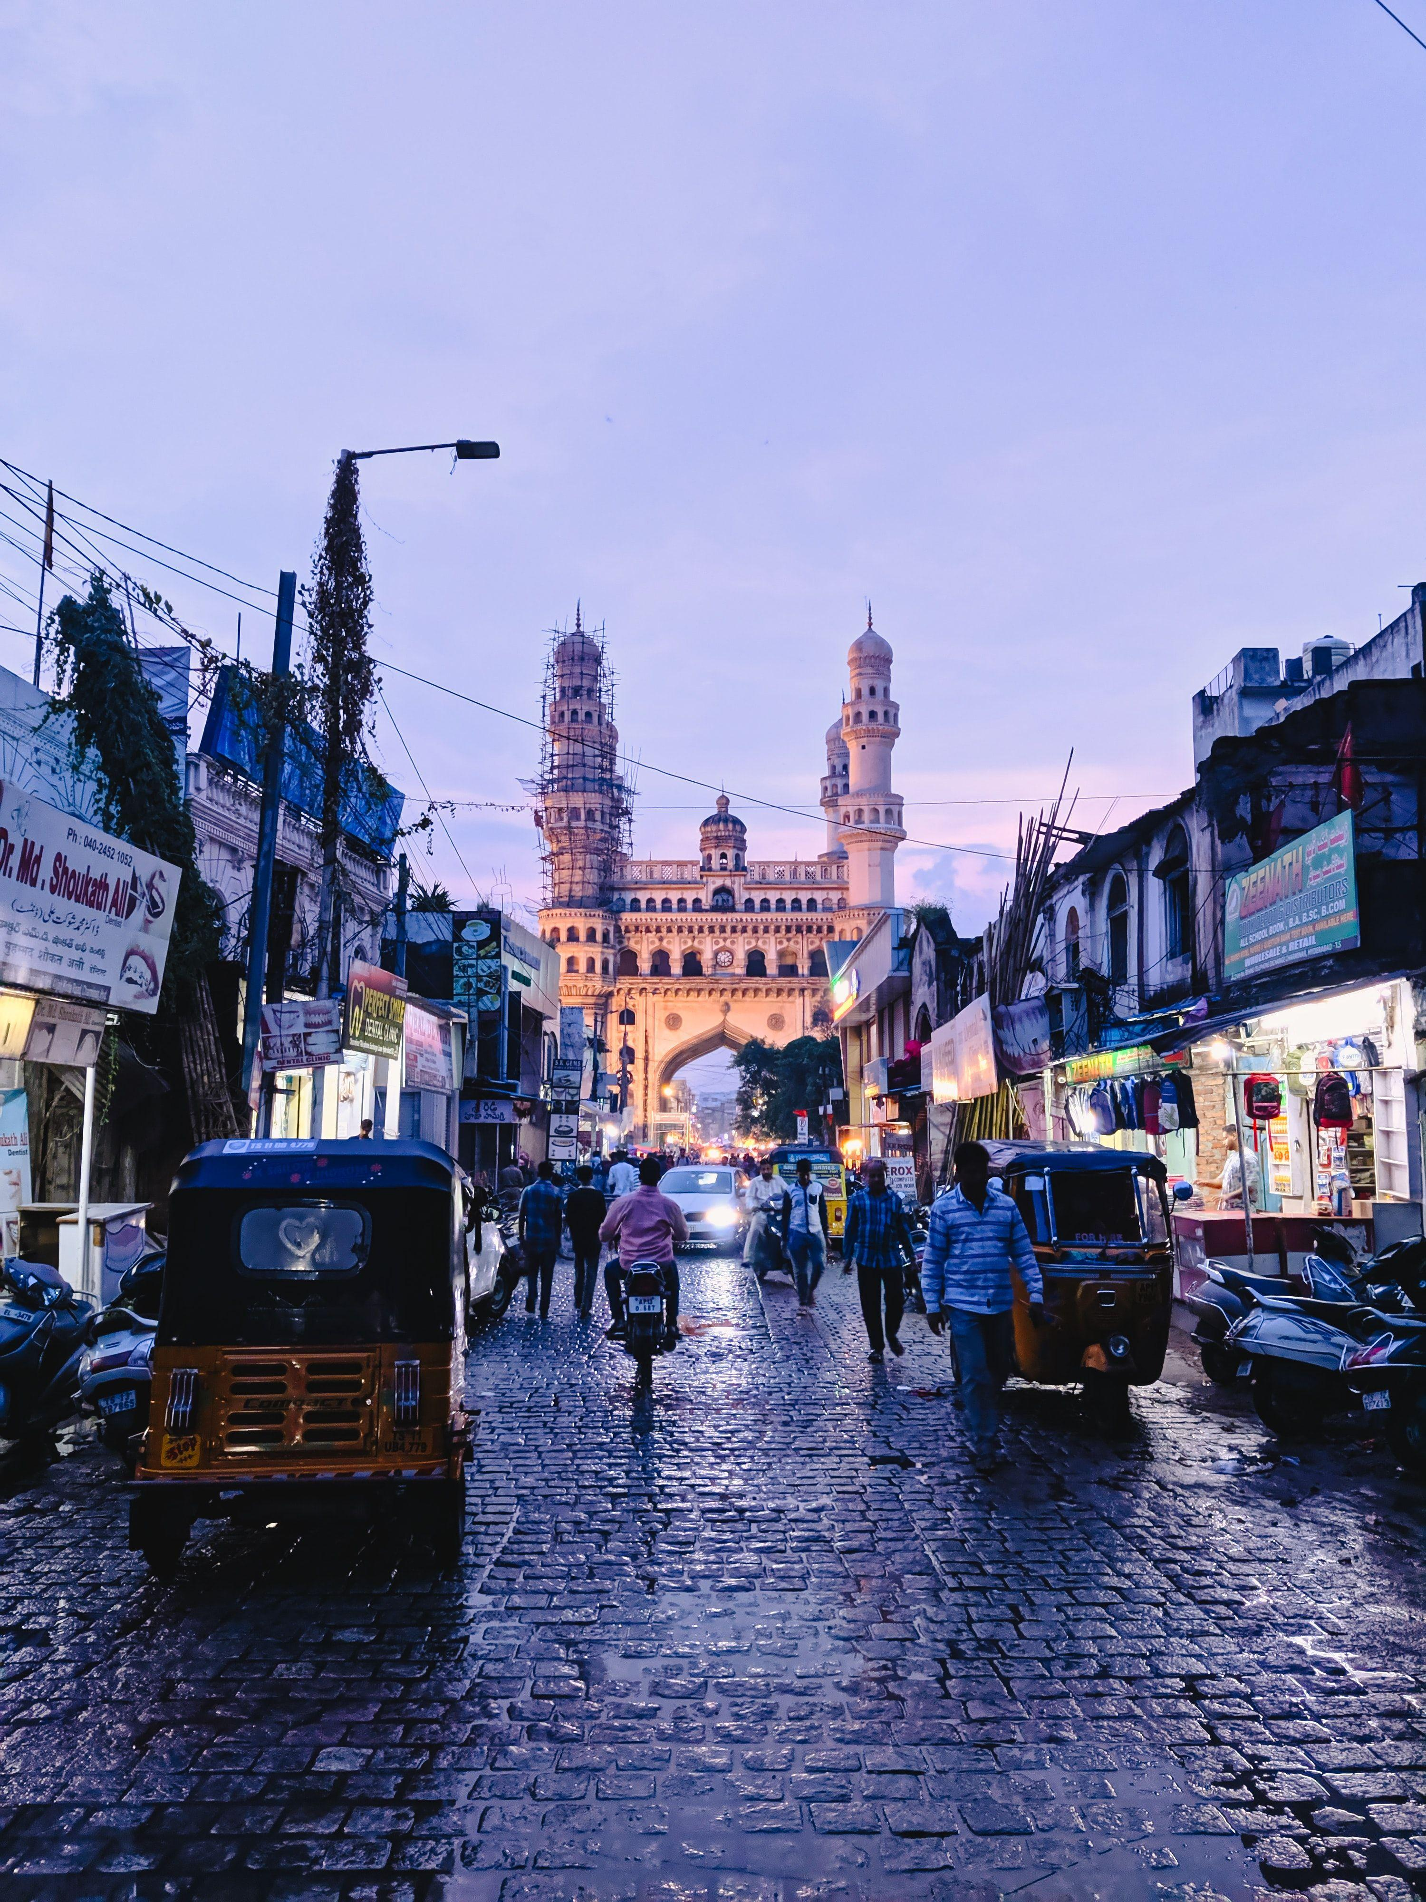
Provide Insights For Telangana Govt Tourism Department

Slide 2
Objectives
Telangana is one of India’s leading states and has published its tourism data under its open data policy.
As a data analyst, Peter Pandey saw this as an opportunity to expand his skills and show his work on a bigger scale.
Peter Pandey’s idea is to find the patterns in the given data, do additional research, and give data-informed recommendations to the Telangana government which can be used to increase their revenue by improving administrative operations.

Slide 3
Data And Tools
The provided data is in separate 8 files ( 4 for domestic visitors & 4 for Foreign Visitors) combined them into two separate files using Python
Combined two separate files together into one in the Power Bi Query
Using Dax to calculate measures and conditional Columns
Create Visualizations in Power BI

Slide 4
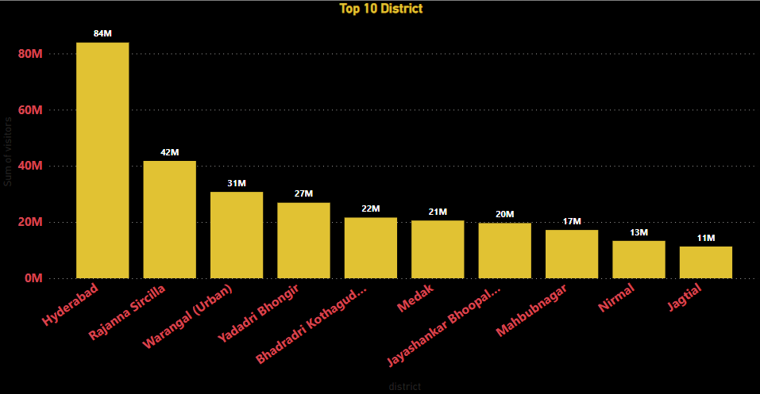
Q1. List down the top 10 districts that have the highest number of domestic visitors overall (2016 - 2019)?
Insight
Out of 33 district, Hyderabad city has the highest number of domestic tourists from 2016 to 2019 which are approx. 84 Million followed by Ranjana Sircilla has 45 M tourists and Jagtial is at the tenth place have 11 M tourists

Slide 5
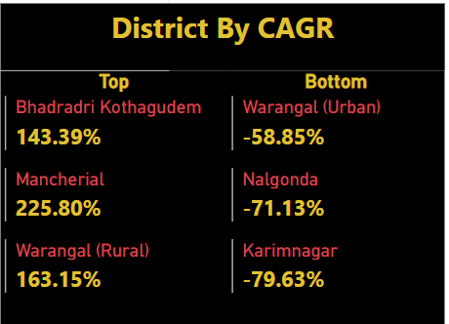
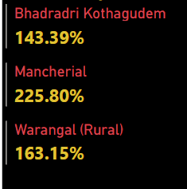
Q2. List down the top 3 districts based on compounded annual growth rate(CAGR) of visitors between (2016 - 2019)?
Insight
Bhadradri Kothagudem, Mancherial, Warangal(Rural) are performing well based on CAGR of visitors. Mancherial Compound Annual Growth Rate increased by 226% in 2019 from previous years

Slide 6
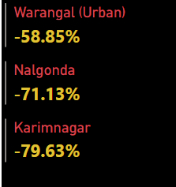
Q3. List down the bottom 3 districts based on compounded annual growth rate(CAGR) of visitors between (2016 – 2019?
Insight
Warangal(Urban), Nalgonda and Karimnagar Compound Annual Growth decreasing from previous years.
Special Attention is given to these areas will boost their tourist attraction

Slide 7
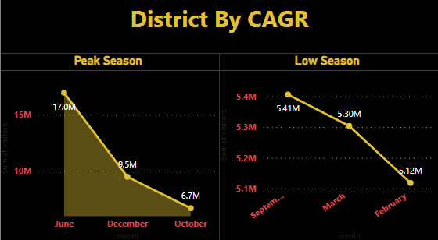
Q4. What are the peak and low season months for Hyderabad based on the data from 2016 to 2019 for Hyderabad district?
Insights:
June, December and October are peak months out of which June and December are attracts lots of tourist.
February, March and September are low seasons and February month attract less number of tourists compared to rest 11 months. By introducing various activities and events can attract the tourist

Slide 8
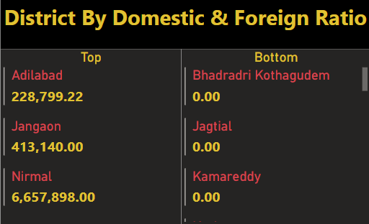
Q5. Show the top & bottom 3 districts with high domestic to foreign tourist ratio?
Insights :
Nirmal, Jangaon and Adilabad are having higher Domestic to Foreign Tourist Ratio.
Observing the top performing district and Replicating them in bottom Districts can attract the foreign tourist which will bring more revenue.

Slide 9
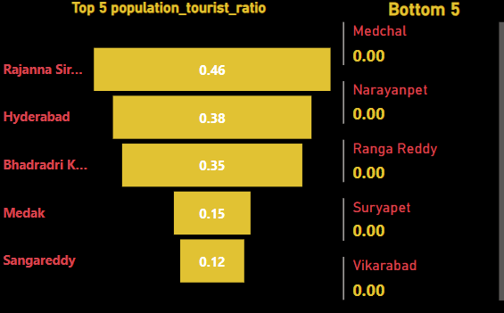
Q6. List the top & bottom 5 districts based on ‘population to tourist footfall ratio* ratio in 2019 ( * ratio: Total Visitors / Total Residents Population in the given year)
Insights :
Proper Advertisement of Bottom district with the places to visit must be done.
The basic facilities in these areas like transportation, Hotels, etc must be compared with top perfuming districts and necessary actions must be done to improve them if its needed.

Slide 10
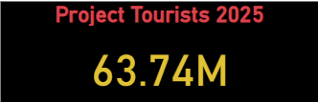
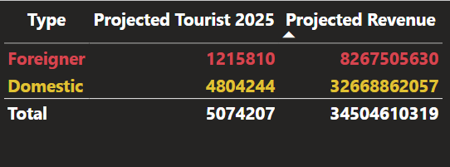
Q7. What will be the projected number of domestic and foreign tourists in Hyderabad in 2025 based on the growth rate from previous years?
Insights :
As by CGAR,
Domestic Tourist in Hyderabad will be 4,804,244
Foreign Tourist in Hyderabad will be 1,215,810
Overall Estimated Tourists in 2025 will 63.74 M in all Telangana State

Slide 11
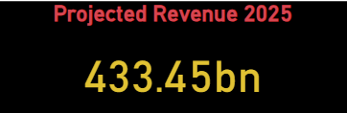
Q8. Estimate the projected revenue for Hyderabad in 2025 based on average spend per tourist (approximate data)
Insights:
In 2025 Domestic and Foreign and Domestic Tourist Both will bring approx. 35 Billion INR revenue.
Total Revenue 433 Billion will generate by 33 district in 2025 with proper planning

Slide 12
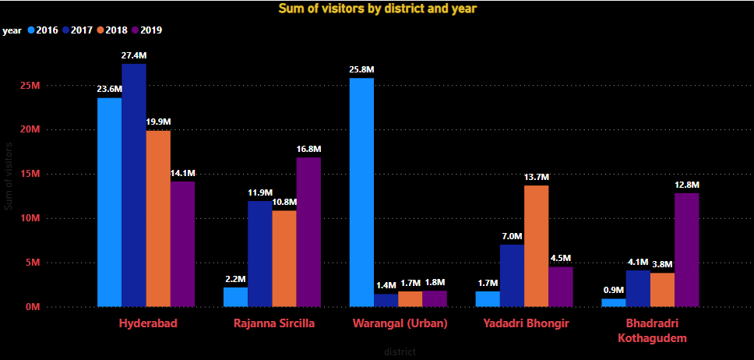
Q9. Districts with highest potentials. A. Which districts has the highest potential for tourism growth and what actions government can take?
Insights :
The district with highest potential for tourism growth are Hyderabad , Warangal(Urban) and Rajanna Sricilla .
Proper Planning can further boost the Tourism in other areas also like Promoting Historical places, Wildlife Sanctuaries and Museum which displays the history of particular District.
Another option create Tourist attraction sports like Park, Lake or cultural program which shows Telangana culture.

Slide 13
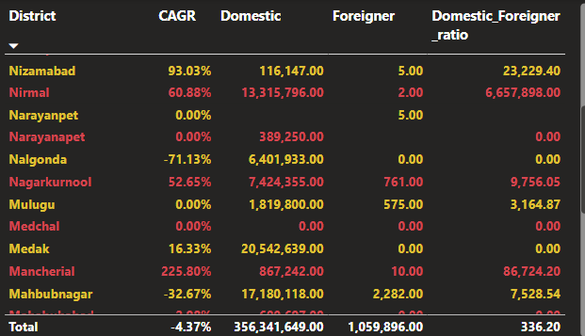
Q10. Cultural / Corporate Events to boost tourism. A. What kind of events the government can conduct.
B. Which month(s)? C. Which districts?
Insights :
Events
Telangana Food Festival, Handicraft and Handloom exhibition are great ideas to showcase Telangana rich culture and attract Tourist.
Dance Festival , Carnival will conduct to boost tourists
Hyderabad, Rajanna Sircilla and Wrangal (Urban) will be good choice for such events in the month of June And December
Sport Activities can conduct in February, March to increase Tourist growth

Slide 14
Q11. Dubai has made itself a business hub and enjoys massive business tourism. Can Hyderabad emulate the Dubai model? Provide insights based on your research.
Insights :
Yes, Hyderabad has The potential to Emulate Dubai Model.
Developing Infrastructure : Dubai has very well developed infrastructure which helps business in doing and by improving the infrastructure in Hyderabad it can attract more business tourists.
Business friendly Environment : Its very convenient to business in Dubai, because of the business friendly environment and by simplifying the regulations in Hyderabad and introducing tax incentives can help in achieving the same in Hyderabad.
Key Industries : Dubai has focused on key industries and identifying the key industries and focusing on its strengths like IT, biotech and pharma can attract more business and tourists.

Slide 15
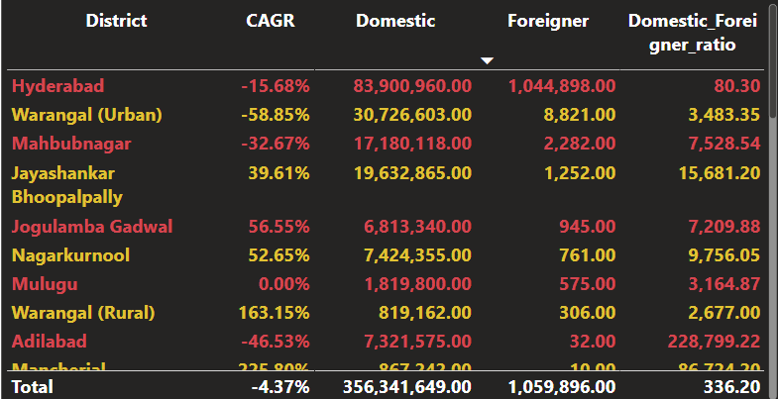
Q12. Provide all other recommendations that can boost the Telangana tourism, particularly Hyderabad.
Insights :
Highlighting Hyderabad rich history and cultural heritage through campaigns and social Media can attract Tourists.
Restoring and preserving Hyderabad historic Monuments, Buildings and landmarks can help in showing Hyderabad rich heritage.
Collaborating with international organizations and tourism boards to promote Hyderabad's heritage to a global audience can attract tourists from around the world.

Slide 16
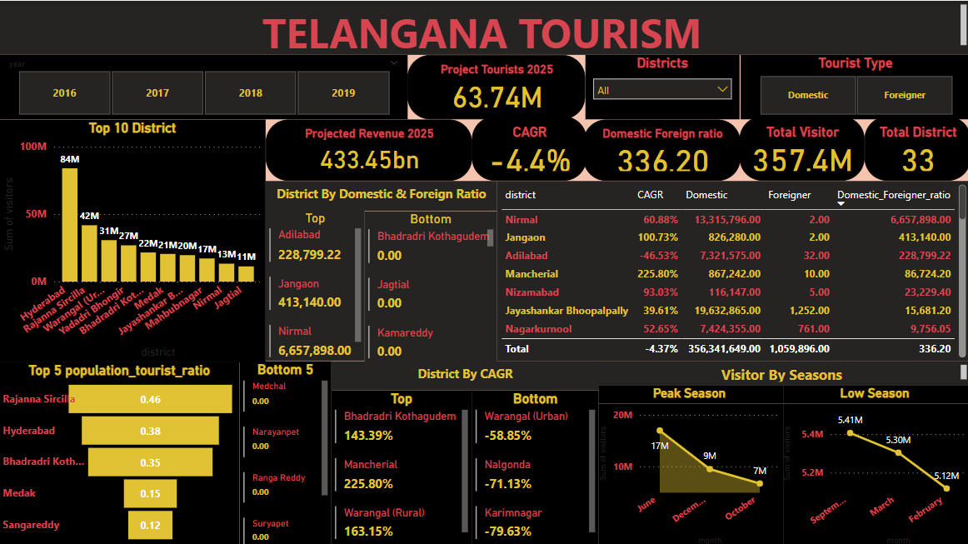
Report

Slide 17
THANK YOU
Sukhpaldeep Kaur

